Slide 1

Oura Ring Synthetic Data Generation
Kristina White
Notes:
The Oura Ring is a wearable device that uses sensors to capture meaningful data from the user and deliver personalized health insights to the user.

Slide 2
Synthetic Data
Artificially created
Useful when large amounts of relevant data are not available or are expensive to produce
Avoids privacy concerns that limit who has access to the data and how the data can be used

Slide 3
Datasets
Heart Rate Variability
Sleep
Variation in the time interval between heart beats
13 variables
10 observations for 50 users
Each user has a person_id
Hours of sleep each night, average sleep quality rating, and average nightly hrv for 10 weeks
34 variables
50 users over a 3-month period
Each user has a person_id
Data collected during sleep periods
Bedtime/wake-up time
Sleep stages
Sleep scores
Heart rate, respiratory rate, body temperature deviation
Time to fall asleep, sleep duration
Sleep quality indicators
Notes:
Sleep period is a nearly continuous, longish period of time spent lying down in bed.
Sleep score represents overall sleep quality.

Slide 4
Data Generation
Each dataset was created using a hard-coded script
The script was written in R
Data generation:
Random generation (sample()) from specified values
Calculation from other variables
Each script was converted into a customizable function

Slide 5
Personal User Stories
Heart Rate Variability
Sleep
8 personal user stories
Patterns (i.e. consistent/inconsistent, weekend/weeknight) for sleep hours, sleep quality, and hrv
Script: Users were randomly selected
Function: Customize how many users are assigned to each user story. Some stories had code modified to be more flexible with the customizability of the function.
11 personal user stories
Scoring, bedtime, wake-ups, heart rate, and sleep duration patterns (i.e. consistent/inconsistent)
Script: Users were randomly selected
Function: Customize how many users are assigned to each user story. Some stories had code modified to be more flexible with the customizability of the function.

Slide 6
Assumptions
The selected/default ranges of values are reasonable
For randomly generated values, it is sufficient to randomly sample values within a specified range rather than imposing a formula, pattern, or distribution
Each user remains in the same time zone for the Sleep dataset

Slide 7
Results
Two datasets and accompanying functions
High correlation between variables that were calculated from each other or the same variables
Lack of correlation among randomly generated variables, even if those variables may be correlated in real data

Slide 8
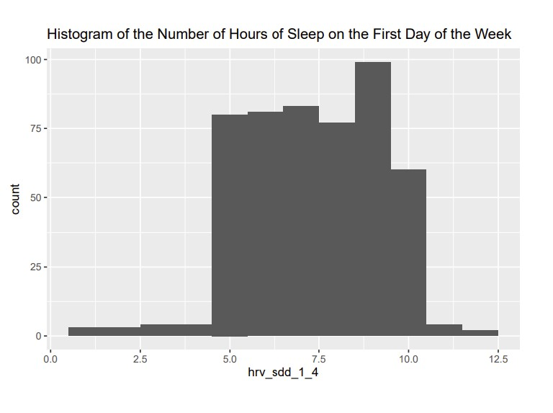
Heart Rate Variability EDA
Personal user stories add more extreme values
Low standard deviations, so the data were not very spread out
Nightly averages of 7-8 hours of sleep

Slide 9
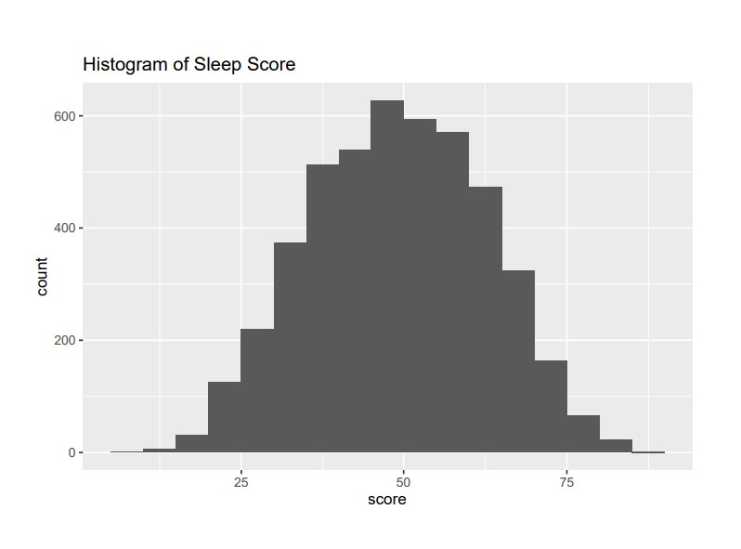
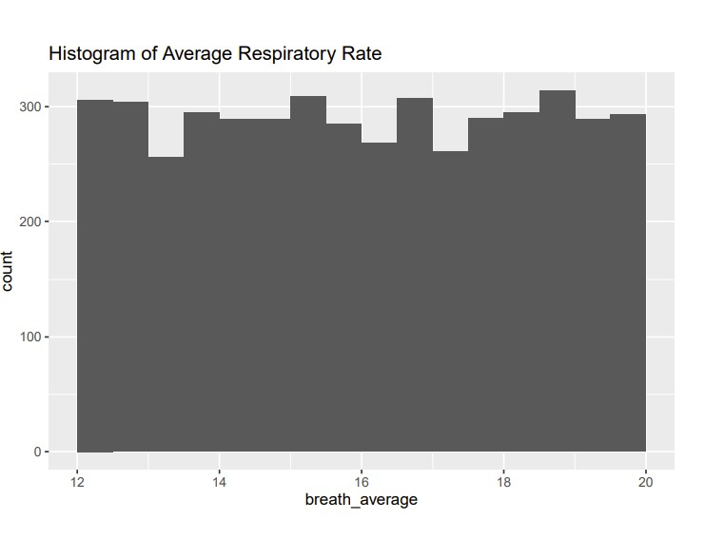
Sleep EDA
Most numeric variables follow either bell curves or uniform distributions
High standard deviations, spread out data

Slide 10
Applications
Development of machine learning/AI models
Sleep analysis/sleep study
Results of models/analyses can inform better health recommendations or information provided to users of wearable technology

Slide 11
Questions?

